Slide 1

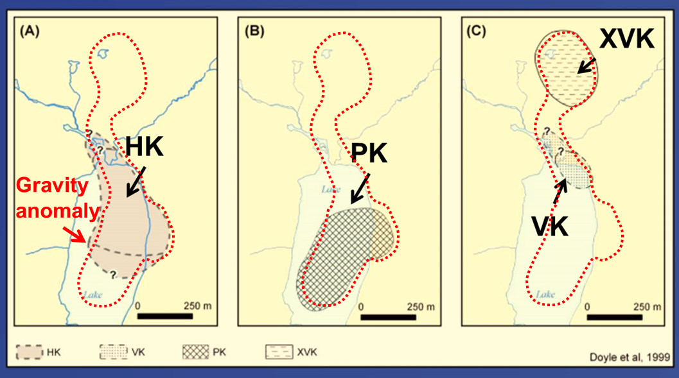
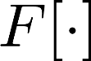
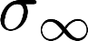
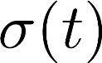
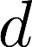
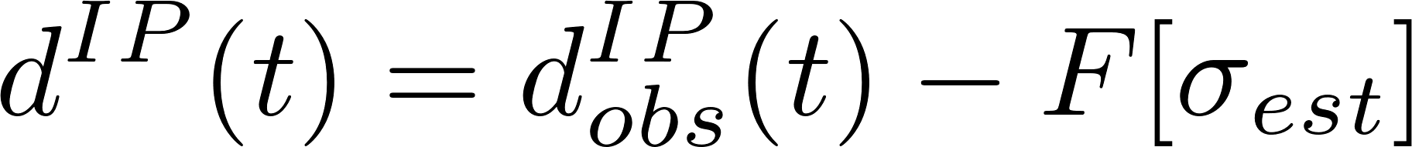
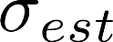
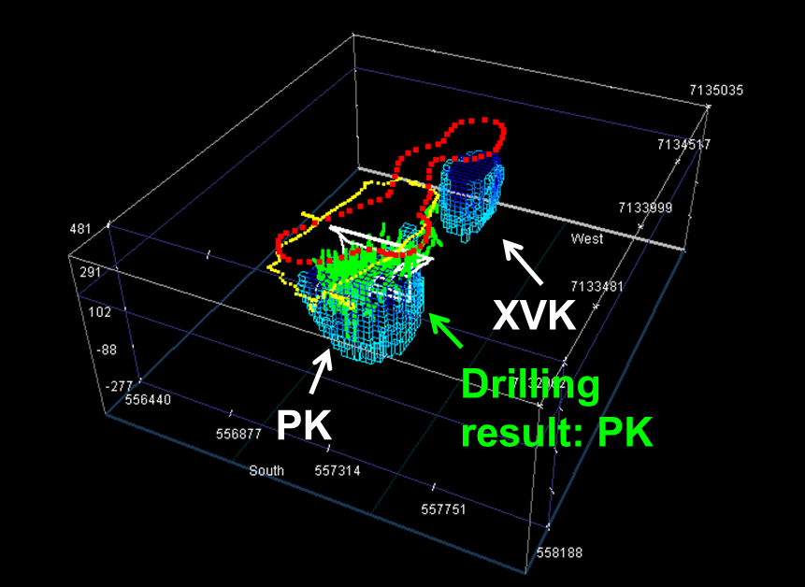
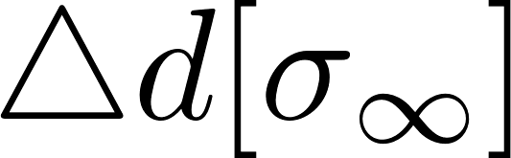
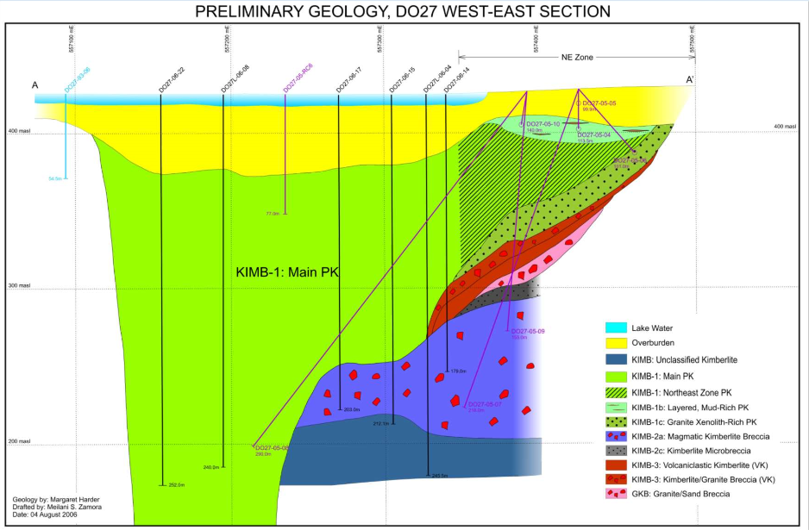
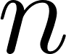
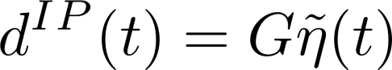

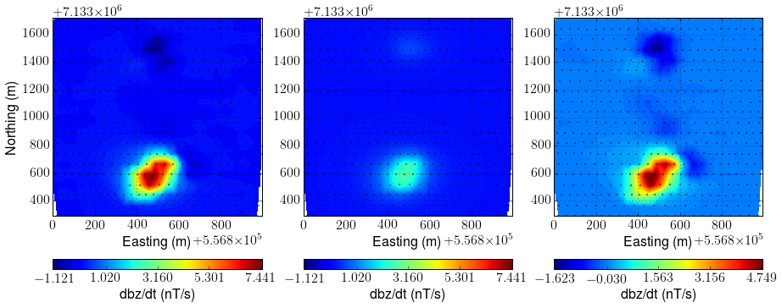
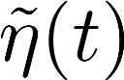
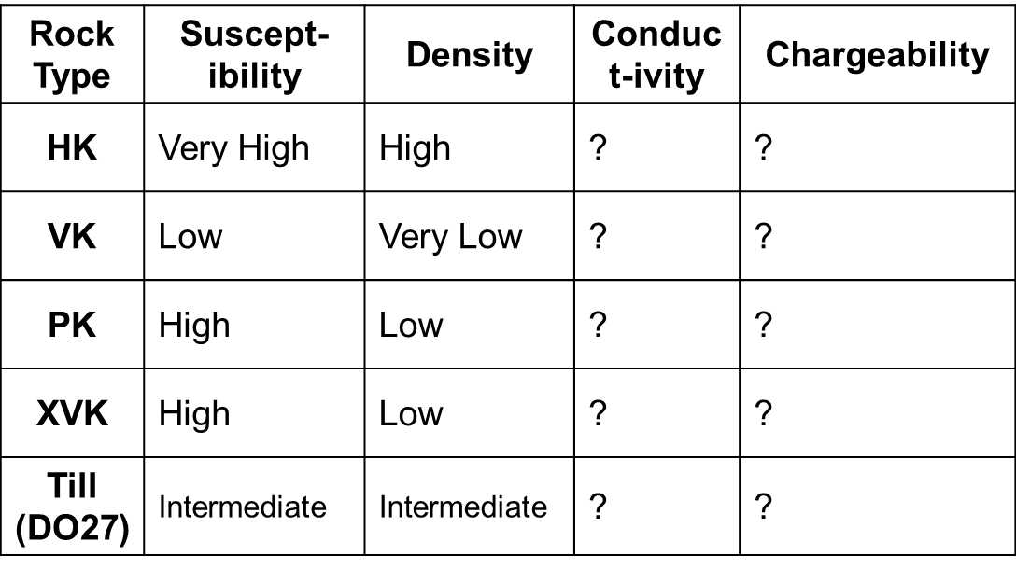
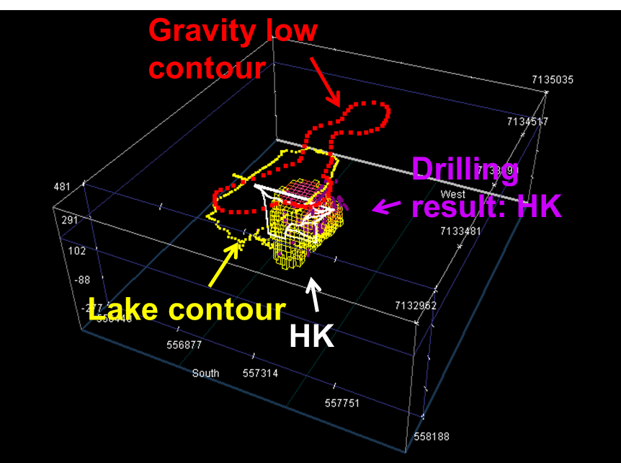
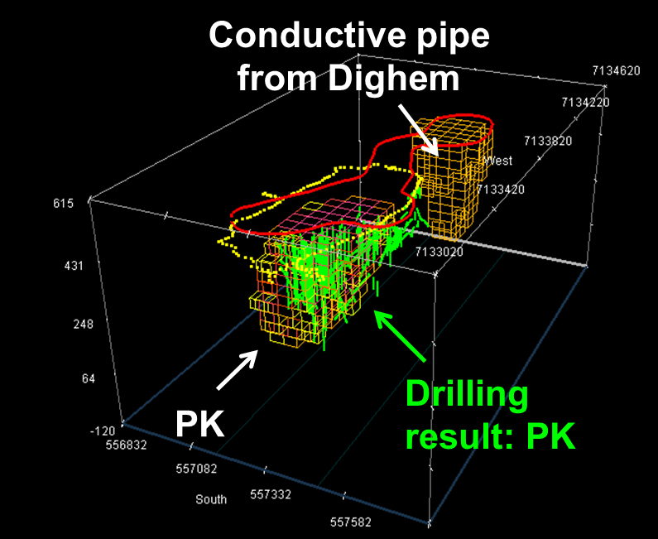
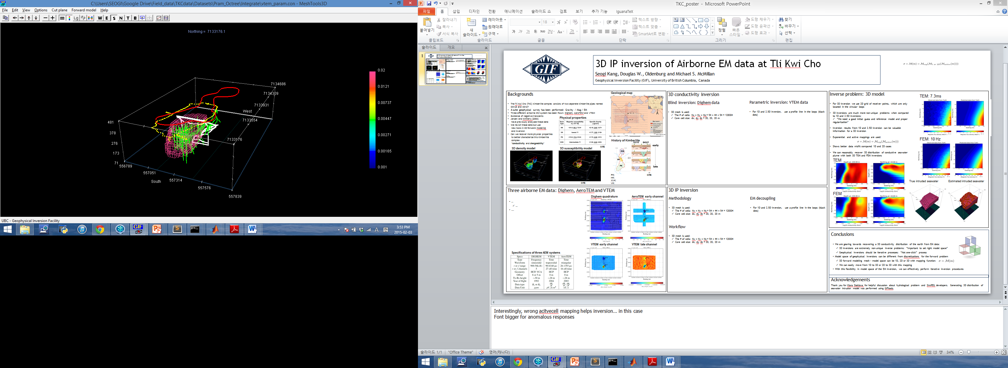
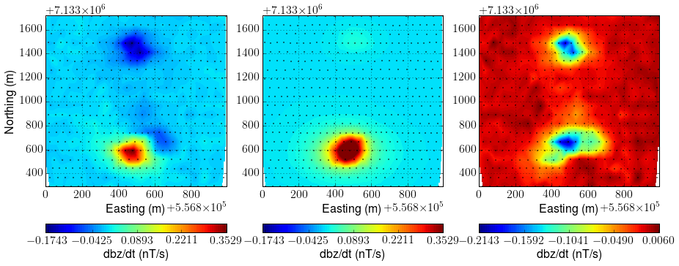
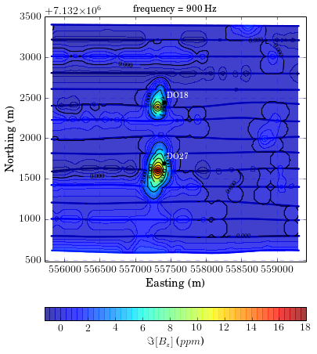
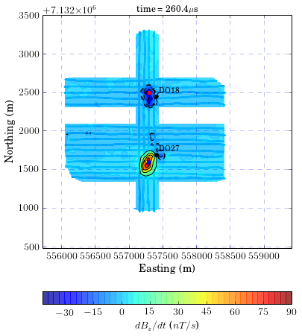
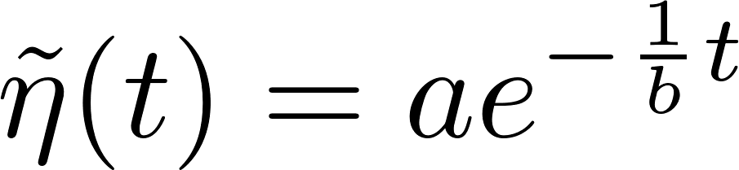
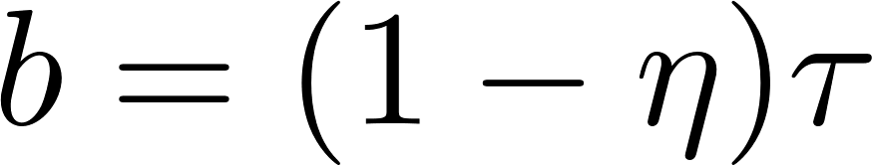


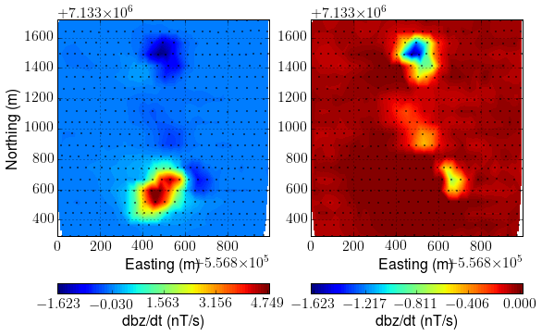
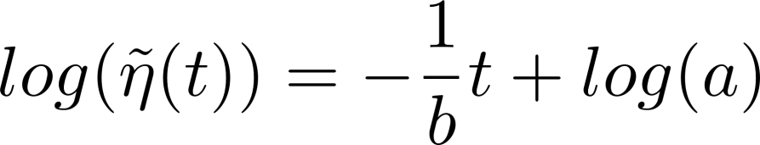
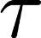
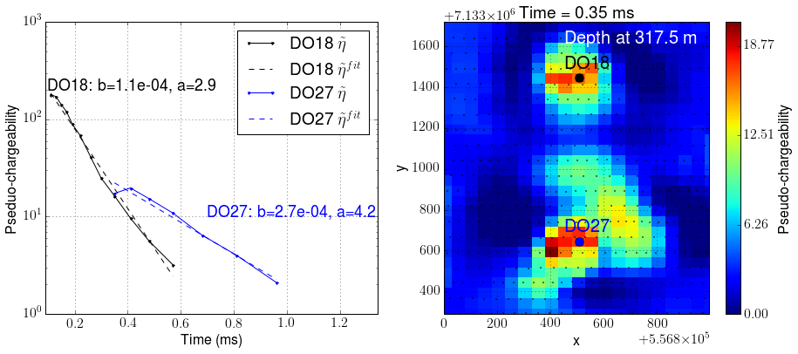
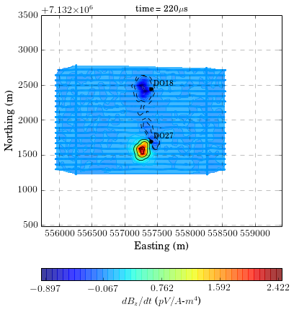
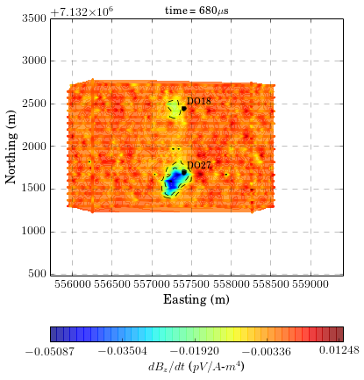
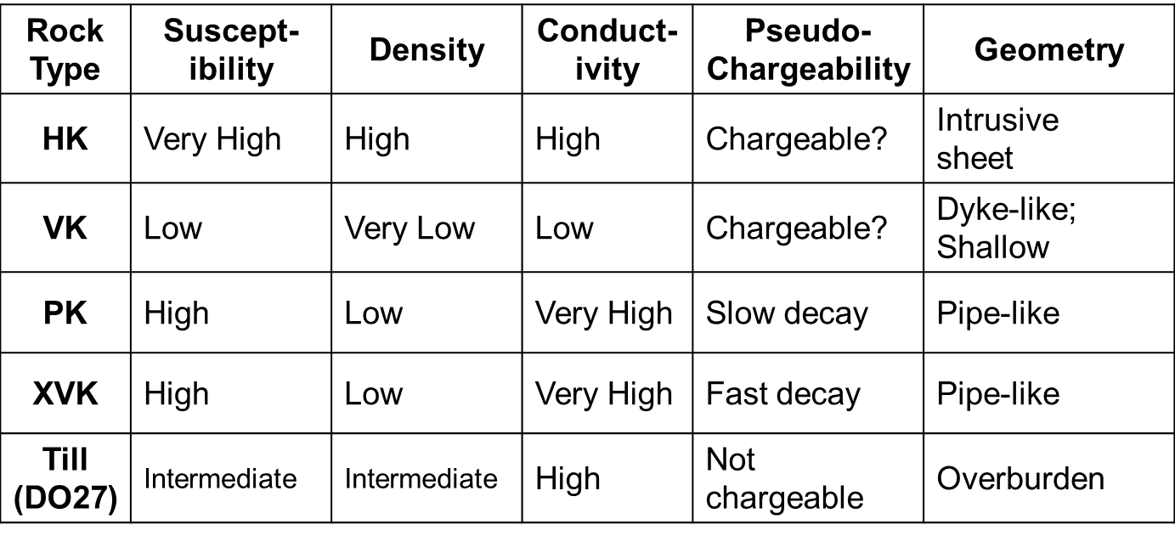
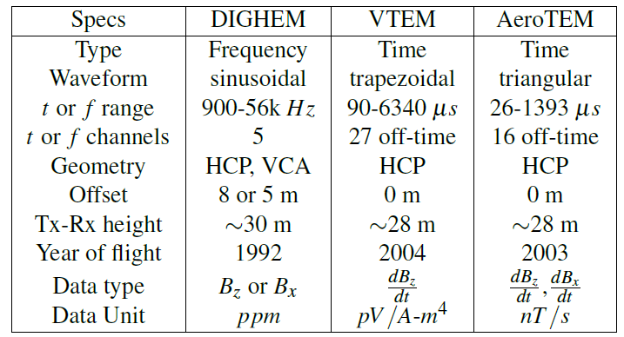
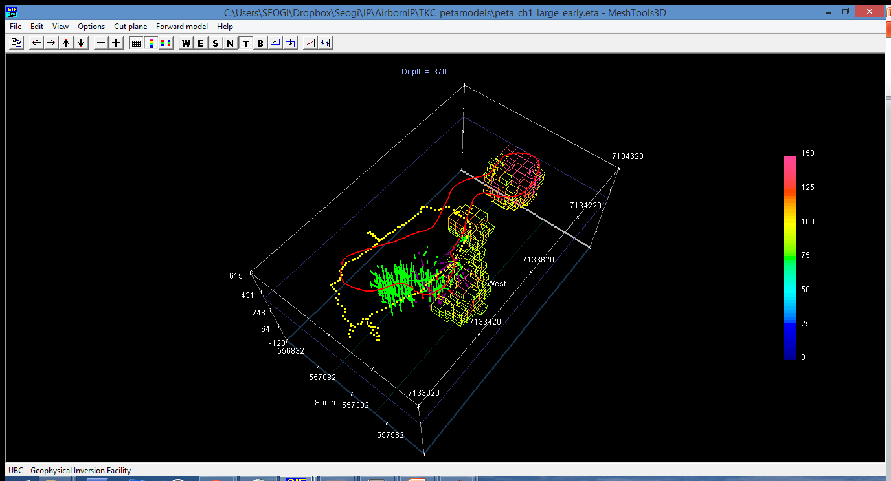
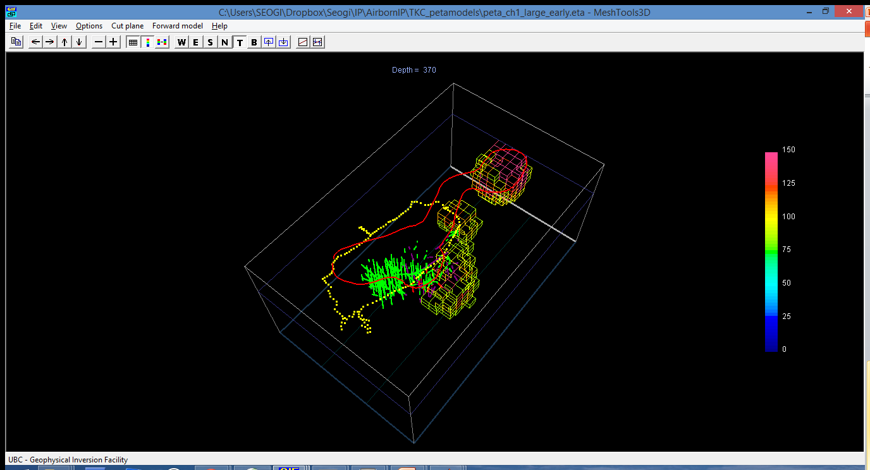
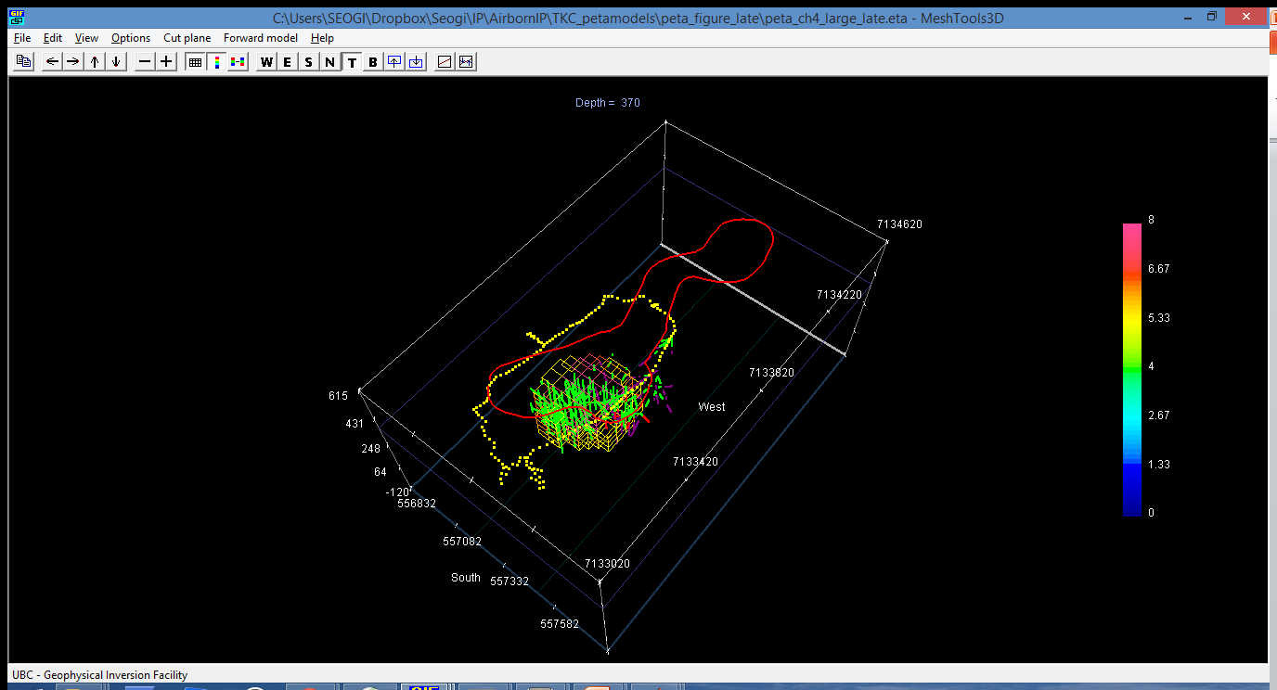
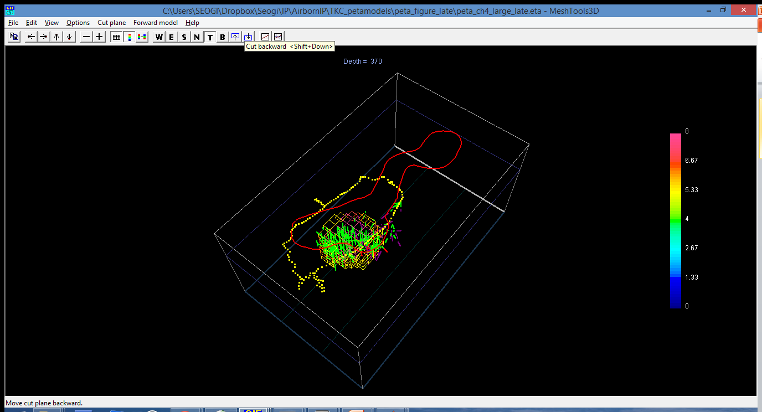
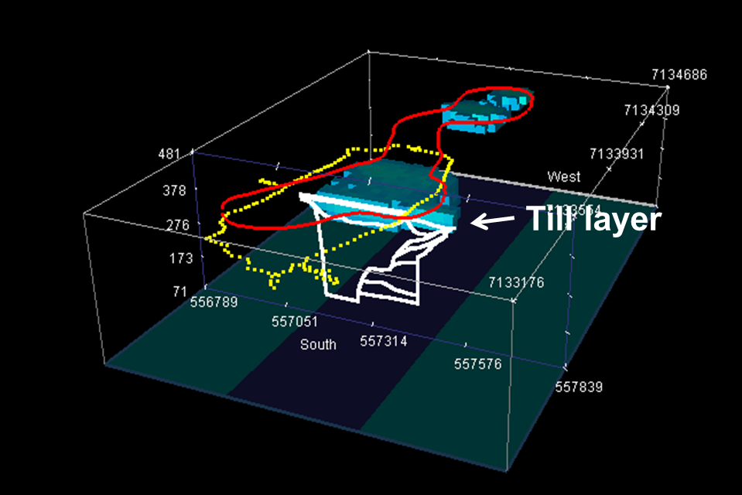
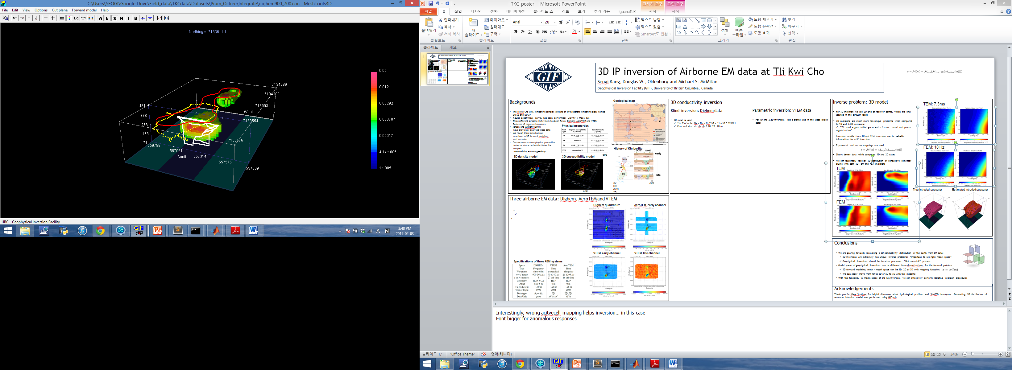
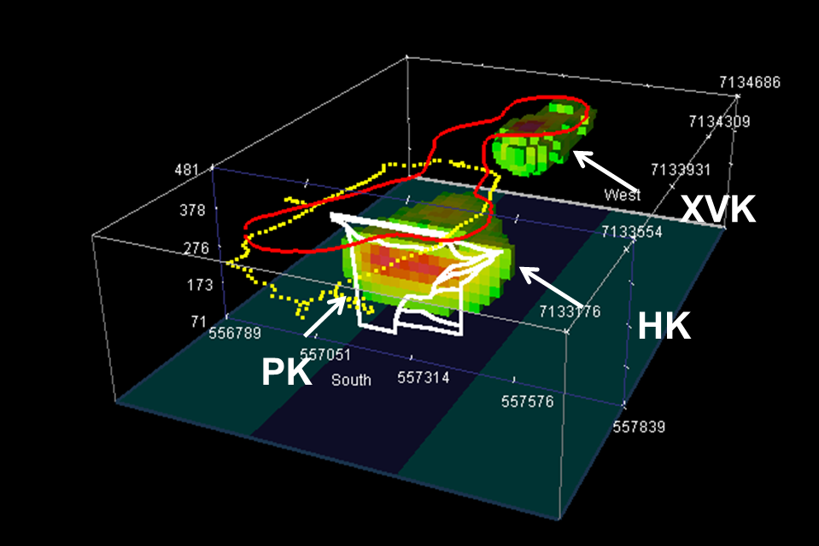
3D IP inversion of Airborne EM data at Tli Kwi Cho
Seogi Kang, Douglas W. Oldenburg, and Michael S. McMillan
Geophysical Inversion Facility, University of British Columbia, Canada
Background
Tli Kwi Cho (TKC) kimberlite complex
Two separate kimberlite pipes: DO-18 and DO-27
Four different geological units: HK / VK / PK / XVK
DO27 is below lake: have thicker till layer than DO18
Geophysical surveys: Gravity / Magnetics / EM
Airborne EM systems: Dighem, AeroTEM and VTEM
Previously analysed by Jansen and Witherly (2004)
We revisit these data sets with modern 3D tools
Methodology of IP inversion
· Maxwell’s operator,
· conductivity at infinite frequency
· time dependent conductivity
· arbitrary EM data
· Superscript F indicates fundamental response
IP datum
EM decoupling:
Need a 3D conductivity distribution
Invert EM data after ignoring IP contaminate data
IP inversion
Linearize IP responses in terms of pseudo-chargeability (Kang et al., 2014)
Linear form of equation:
3D density model
Modified from Doyle et al., 1999
· : Estimated conductivity model from 3D TEM inversion
· : Error caused by a poor estimate of the conductivity
· : Noise
Geological section (DO27)
Till
VK
· PK: Pyroclastic Kimberlite
· HK: Hypabyssal Kimberlite
· XVK: Xenocryst-rich Volcaniclastic
Kimberlite
· VK: Volcaniclastic Kimberlite
PK
Observed
Predicted
d^{IP}obs
· : sensitivity function
· : pseudo-chargeability
HK
3D susceptibility model
0.09 ms
Conductivity model
Combination of Dighem and parametric inversion conductivities.
Modified from Harder et al., 2006
Physical properties
EM dominant
0.3 ms
Conductivity (s/m )
Modified from Jansen et al., 2004
Devriese et al., 2014
Both EM and IP
Airborne EM data: Dighem, AeroTEM and VTEM
3D IP inversion
Estimate intrinsic IP parameters
Analyze decay features of pseudo-chargeability
Let
and is arbitrary constant
Take log we have
Linearly fit pseudo-chargeability at two locations corresponding to DO18 and DO27 pipes
Frequency domain: Dighem
High anomalies near DO18 and DO27
Pipes more conductive than background
Time domain system: AeroTEM
Early time channel: similar to VTEM
Later times: negative near DO27 (N3)
Negatives due to chargeable material (Weidelt, 1982)
Dighem
Quadrature 900 Hz
AeroTEM: 0.26 ms
(early time)
Processing
may be significant for time channels
Keep only negative d^{IP} data
N1
where
· : Chargeability
· : Time constant
N2
Raw d^{IP}
Processed d^{IP}
Time domain system: VTEM
Early time channel:
· Positive high near DO27
· Negative near DO18 (N1)
Late time channel:
· Negative between two pipes (N2; dyke-like shape anomaly)
VTEM: 0.22 ms
( early time )
VTEM: 0.68 ms
( late time )
N1
N1
Pseudo-chargeability model
Invert each time channel separately
Recovered pseudo-chargeability shows:
· Early time: chargeable bodies near DO18 (XVK unit) and dyke feature (HK and VK)
· Late time shows chargeable body near DO27 (PK unit)
Synthesis
Airborne EM systems
N2
N3
At 0.09 ms (Early time)
At 0.5 ms (Late time)
VK?
XVK
3D conductivity inversion
Dighem 56k inversion
Pseudo-chargeability
Pseudo-chargeability
Voxel-based inversion: Dighem data
56k Hz response sensitive to near surface
· Considered as “lake bottom detector”
· Recover till layer model near DO27
3D inversion using 900 and 7200 Hz responses
· Sensitive to deeper conductivity
· Recover conductive structures on three
regions close to N1, N2 and N3
Drilling
result: HK
HK?
PK
Drilling result: PK
Conductivity (s/m )
Dighem 900 and 7200 Hz
inversion
Conclusions
Geophysical/ Geological Implications
We’ve recovered information about 4 physical properties associated TKC
Inversion of EM data is interpreted in terms of 4 kimberlitic units. Supports drill results
Lake sediments/till are conductive but not responsible for total conductivity response
Pipes have different IP features. This may be a potential diagnostic feature
Recovered 3D conductivity models from EM data
· DIGHEM : voxel based inversion
· VTEM: Hybrid Parametric/Voxel inversion
EM decoupling for VTEM data. Computed d^{IP} datum for each time channel
Inverted d^{IP} data: yielded 3D pseudo-chargeability model for each time channel
Analysis of pseudo-chargeabilities:
DO18: “fast” decay DO27: “slow” decay
Hybrid Parametric/Voxel inversion: VTEM data
Challenges:
· All data near N1 and N2 are negative: even the earliest time channel!
· Data are noisy away from pipes
Parameterize DO27 structure as skewed-Gaussian ellipsoid
· 11 unknown parameters (McMillan et al., 2014)
· Ignore all negative transients
Till on DO27 is less conductive than the pipe
Fournier et al., 2014
VTEM inversion
Conductivity (s/m )
Acknowledgements
We thank Ken Witherly from Condor Consulting, Inc. and Jennifer Pell for from Peregrine Diamonds Ltd. for providing data and background information about TKC. We thank Dom Fournier, Sarah Devriese and other UBC-GIF members for their participation in processing EM data sets and investigating the geological background of this region. Thanks also to SimPEG developers.
0.05 S/m
Drilling result: PK
* White line: 2D geological section

